Slide 1
Genetics
Field of Biology based on understanding how characteristics are passed from parents to offspring.
Mckenna, Caroline, Emmie, Lisa

Slide 2
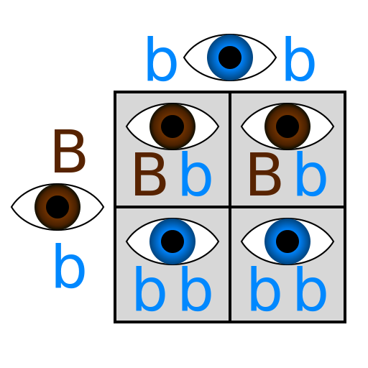
General Definitions
Allele→ alternate form of a gene
Complete dominance→ one allele completely hides the other
Incomplete dominance→ both alleles influence the phenotype (blending)
Codominance→ Neither allele completely hides the other (both are seen) (blood typing & spots)
Trait→ an expressed gene
Dominant→ the gene that will always be expressed whether homozygous or heterozygous
Recessive→ requires a homozygous pair in order to be expressed
Homozygous→ matching pair
Heterozygous→ two different alleles (not a matching pair)

Slide 3
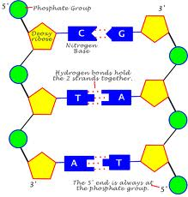
DNA
Deoxyribonucleic Acid
Double helix structure (by Watson and Crick)
Stores and transmits genetic information that tells cells which proteins to make and when to make them, made of nucleotides
Parts of the nucleotide
Sugar molecule→ deoxyribose
Phosphate group→ phosphorous and oxygen
Nitrogen base→ adenine, cytosine, guanine, thymine
Nitrogen Bases
Complimentary base pairing→ describes the pairing of the two bases (cytosine with guanine, adenine and thymine)
Purines→ two rings, adenine and guanine
Pyridamines→ one ring, cytosine and thymine

Slide 4
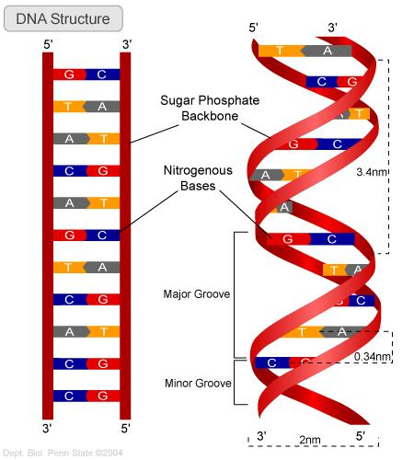
DNA Replication & Protein Synthesis
Replication
Starts with 1 DNA strand
Ends with 2 identical RNA strands
Takes place in the nucleus
Enzymes
DNA Helicase→ unwinds and unzips DNA
DNA Primase→ sets primers for the new nucleotides
DNA Polymerase → lays down the new nucleotides
DNA Ligase→ glues together the newly made DNA

Slide 5
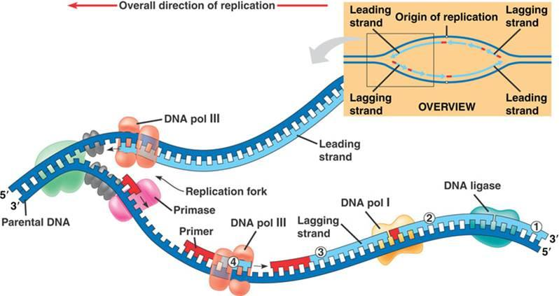
Transcription & Translation
Makes mRNA from DNA
Takes place in the nucleus
Steps
RNA polymerase binds to DNA
Separates DNA strands
RNA polymerase uses a single DNA strand as a template, and lays down nucleotides
Forms the correct protein
Steps
The mRNA leaves the nucleus and enters the ribosome
The mRNA strand is used to produce tRNA, and from there match the codons with the correct amino acid
*remember* mRNA determines the protein, NOT tRNA

Slide 6
Mitosis
Deals with the division of body cells
PMAT
Prophase→ chromatin condense and nucleus disappears
Metaphase→ chromosomes align to the center of the cell
Anaphase→ pair of chromosomes move to opposite poles
Telophase→ daughter chromosomes arrive at poles, the nucleus reappears, and chromosomes disappear
Cytokinesis→ the division of the original cells in the cytoplasm

Slide 7
Meiosis
Results in 4 daughter cells each with half the number of chromosomes of the parent cell
Independent Assortment→ random assortment of chromosomes
Crossing Over→ exchange of genes, mixture of parental traits
Genetic Recombination→ (result of crossing over) 2 DNA molecules exchange genetic information
http://ed.ted.com/lessons/sex-determination-more-complicated-than-you-thought

Slide 8
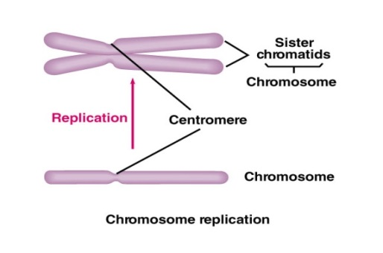
Chromosomes
Contain the genetic information that is passed along from one generation to the next
Karyotype→ photograph of chromosomes grouped in order of pairs
Homologous Chromosomes→ chromosomes of a ‘matching pair’ (not identical)
Haploid→ 1 set of chromosomes (N)
Ex: egg and sperm cells
Diploid→ 2 sets of chromosomes (2N)
Somatic cells→ body cells (diploid & mitosis)
Gametes→ sex cells haploid & meiosis)
Humans have 23 kinds of chromosomes (46 total)
1 copy from mom, 1 copy from dad
Mom and dad aren’t identical, so the chromosomes are similar
Tetrad→ 2 homologous chromosomes paired (4 sister chromatids)
Synapsis→ the period of time when a tetrad forms

Slide 9
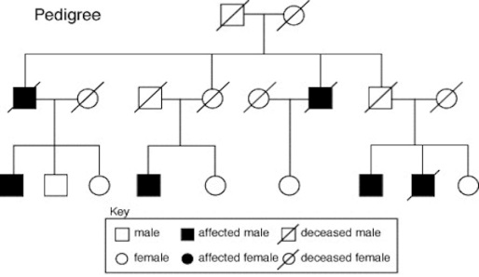
Pedigree
Pedigree→ a chart that maps out the family history of a specific gene

Slide 10
Genetic Disorders
Single Gene Disorder→
A problem in a single dominant/recessive gene is passed down to offspring
Multifactorial Disorders→
Result from mutations in multiple genes passed to offspring
X-Linked Disorders
Mutation or error in genes found on the x chromosome

Slide 11
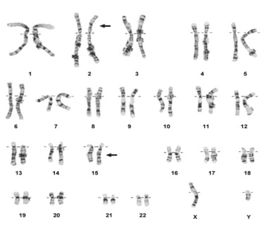
Genetic Disorders Continued
Chromosomal Abnormality→
Entire chromosomes or large segments of chromosomes are missing, duplicated, or altered
Deletion
Duplication
Insertion
Translocation
Nondisjunction→ failure of chromosomes to separate during meiosis
Causes Trisomy 21 (down syndrome)
Karyotype→ a visual appearance of all of the pairs of chromosomes in the body

Slide 12
Genetics Web Lab Directory
Review of Genetic Principles
http://www2.edc.org/weblabs/weblabdirectory1.html

Slide 13
Picture Credits
http://embryology.med.unsw.edu.au/embryology/images/5/57/Pedigree_chart.jpg
http://home.comcast.net/~dmgt350/cytogenetics/images/trans215.jpg
http://theinvestigation.yolasite.com/dna-structure.php
https://teaching.ncl.ac.uk/bms/wiki/images/d/d2/Sister_Chromatids.JPG
http://classconnection.s3.amazonaws.com/804/flashcards/2321804/jpg/dna_replication1353993819115.jpg
http://upload.wikimedia.org/wikipedia/commons/thumb/f/f6/Punnett_hetero_homoblue.svg/512px-Punnett_hetero_homoblue.svg.png

